Slide 1

Wanderlust

Slide 2




Team
The Creators of WANDERLUST
Product and Strategy
Architecture
Product and Strategy
Mock-ups
Nicolas Urbach
Dennis
Mayer
Lukas Oldach
Alexander Kopp
“I don’t plan, I use WANDERLUST.”
“New route, new challenge.”
“WANDERLUST is my weekends favorite.”
“My favorite feature: follow the tips and enjoy the breaks.”

Slide 3
Living Lab
1.
4.
2.
3.

Slide 4
1. Co.-Creation

Slide 5
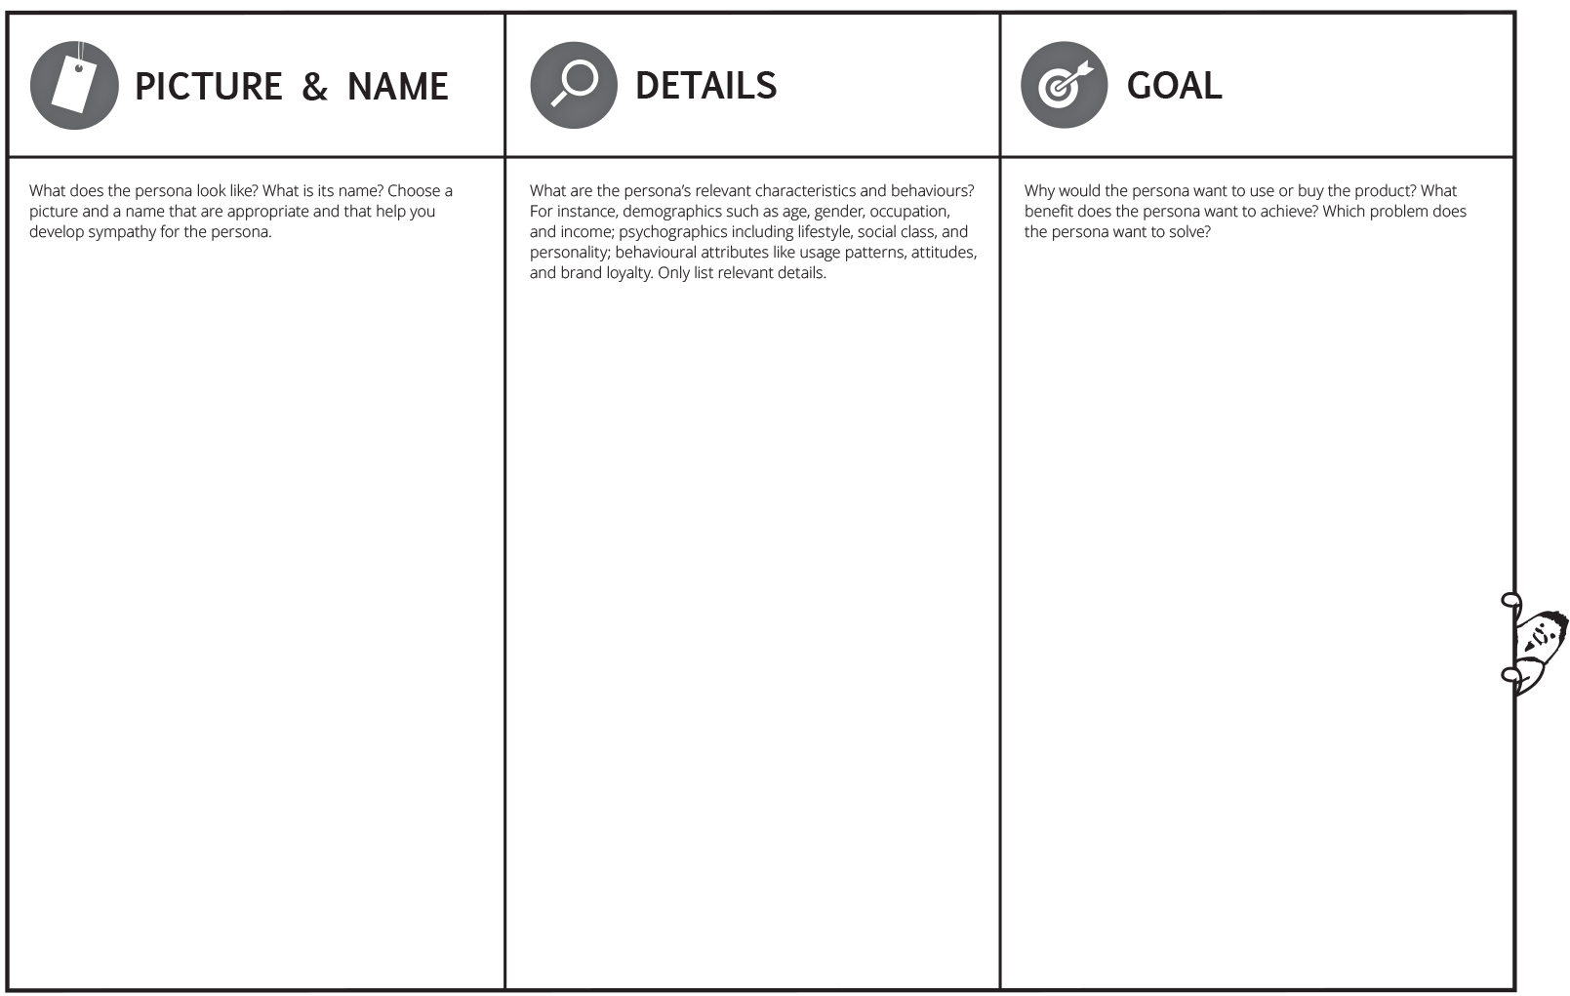
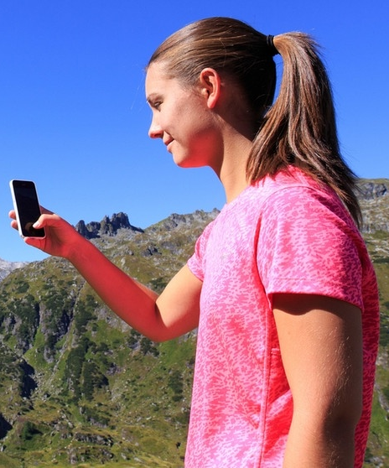
Personas
Focus on hobby hiker
Annemarie
-26 years
-Female
-Works in a advertising agency
-In relationship with Tom (31)
-Sporty person
-Likes yoga
-Likes weekend trips combined with hiking
-Advanced tech savviness
-Wants minimize the planning and navigation efforts before and during the hiking trip
-Wants to have actual information
-Does not want to spent money for unnecessary information (like comprehensive hiking guide)
(-Wants to push her Instagram channel with personal impressions and experiences)

Slide 6
Empathy map canvas
Hobby hiker view
-Hobby hiker
-Information about a hiking trail
-Guiding and exploration service for hiking
-Physical maps
-Hiking is dangerous
-Restaurants are overcrowded
“I just want to go for an easy trip into the mountains without much effort for planning”
-Buy hiking guides
-Use expensive apps
-Prepare their trips with lot of effort via internet

Slide 7
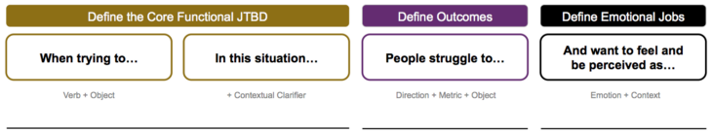
Jobs to be done
Jobs for the customer
…hike in the mountains
…vacation or free time
…prepare their hiking trips
…find the best route depending on their preferences e.g. fitness or time
…get specific map material
…spend money for one time map material
…find the best fitting hiking track
…relaxed during the preparation process and excited and secure while hiking

Slide 8
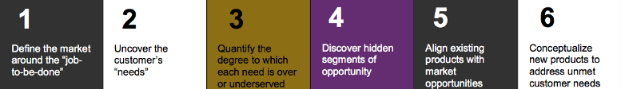
Customer innovation process
When is was tired of searching, I learned to find.” - Goethe
Outdoor activities
Hiking
Outdoor navigation
1. Easy planning
2. On-site information
3. Navigation
4. Real-time information
Rang from 1 – 6
3 -4
3
2
4-5
Seamless navigation
On-site information
More information
Customized information about trails according to the customer need
Hiking – navigation apps
-> just app based information
Maps
-> Comprehensive planning effort required
Signs
-> static and limited
“Wanderlust” offers:
On-site installed information “spots” via Beacons which are able to interact with the hiker in a seamless, natural and comfortable way. Optional functionality to provide real-time information in accordance to the current location and hiker’s individual needs

Slide 9
Product vision board
Providing information and services in an natural environment enabled by the merger of the physical web and the web of things.
Easy and seamless information provision and usage.
Hobby hiker
Outdoor explorer
Micro adventurer
Easy planning
On-site information
Navigation
Real-time information
“Wanderlust” offers:
On-site installed information “spots” via Beacons which are able to interact with the hiker in a seamless, natural and comfortable way.
Platform for individual service offerings form ourselves and partners
Location-based, seamless, embedded in the real world and providing real-time information
Easy to use
Supports an agile “leisure time design”
YES – Standard components aligned in a smart real-world embedded way
Sell an unprecedented service to large and growing customer segment which is able to satisfy an unmet customer need
Platform role in the market
Generate early revenues
Sell up advertising space
Cross sales opportunities
Revenue via partner fees
On-site option for sales
Get wide reach
Early market entrance

Slide 10
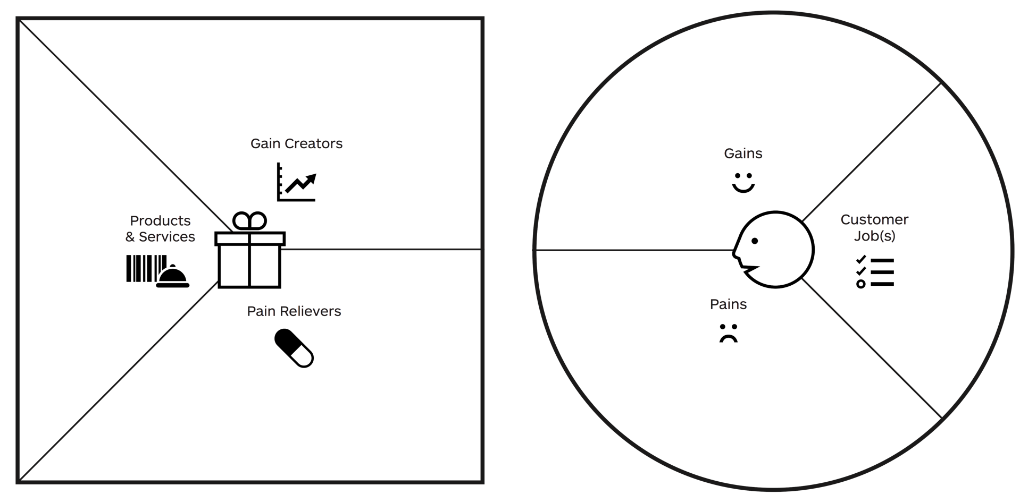
Value proposition canvas
Hiking as a Service
Reduced effort for information gathering
Seamless usage
Proactive interaction
No installation required
Free choice of devices
1. Easy planning
2. Actual on-site information
3. Navigation
4. Real-time information
1. Planning
2. Gathering actual on-site information
3. Navigation
Information service
Platform for partners
Low planning efforts via provision on-site information
Route recommendation
Specific information
Low cost
Actual information
1. Exhausting preparation of hiking trips required
2. Finding the best route depending on personal preferences e.g. fitness or time is just possible in an limited way
3. Specific map material in accordance to the real needs is not available (just comprehensive stuff like big maps or hiking guides
4. Relatively high cost
5. Information often outdated

Slide 11
Business Model Canvas
Key Partners | Key Activities | Value Propositions |  | Customer Relationships | Customer Segments
 | Key Resources |  |  | Channels
Cost Structure |  |  | Revenue Streams
Technical infrastructure (IT Backend and real world)
Maintenance of beacons
Tourism organization
Restaurants
Providing push service for hiking tracks
Maintaining the management platform
Development of platform
Content quality assurance
Professional hiking experience without planning and without spending money on expensive maps / guides
Live information on points of interest along the track
Special offers during the trip
Alternative tracks
No navigation but focus on nature and hiking without following a route on the phone / map
Automated customer relationship to hiker
Personal and automated relationship through management platform
Spontaneous hiker
Local tourism organization
Region
Point of Interest
Restaurants along the hiking
Beacons
Web Services
Management Platform for Beacons and Content
Infrastructure (IT Backend)
Beacons
Web front end management platform
Webservice for hiker
Beacons
IT Infrastructure
Development
Support & Maintenance
Agency service for the preparation of hiking routes
Packaged offers for beacons on hiking trails based on the numbers of Reseller of beacons and consulting

Slide 12
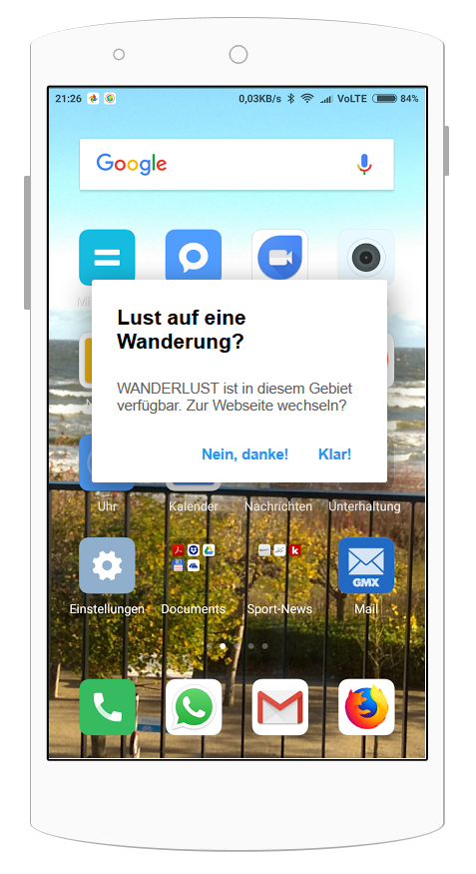



IoT Architecture of WANDERLUST
2
3
Beacon DB
1
5
4
Content DB
Beacon
Smartphone / Browser
Server

Slide 13
IoT Architecture of WANDERLUST
 | Beacon | Smartphone / Browser | Server | Beacon DB | Content DB
Technology | Bluetooth Low Energy | iOS or Android | Application Server e.g. Apache Tomcat | Database Server e.g. MongoDB | Database Server e.g. MySQL
Protocolls | Eddystone | REST Services | REST Services | REST Services | REST Services
Usage | Pushing an unique Eddystome-UID to identify each beacon and a Eddystone URL to a Smartphone nearby based on Bluetooth Low Energy (BLE) technology. | The smartphone / browser is used to trace beacons in an area. It can send and receive data to the server via REST services and can display these data. It is also used by the user for controls of the user interface. | The server is used to receive and send data from and to the smartphone browser. It also check the Beacon DB and the Content DB and push the information back to the Smartphone / Browser. | The Beacon DB manages the Beacons. Here you can change the pushed URLs of each beacon. Thus, the URL of individual beacons can be changed at a later date without much effort using the unique Eddystone-UID. | Within the Content DB all content, that is be pushed from the server to the smartphone, is stored and managed. It can be managed by the users themselves via a content management system.

Slide 14
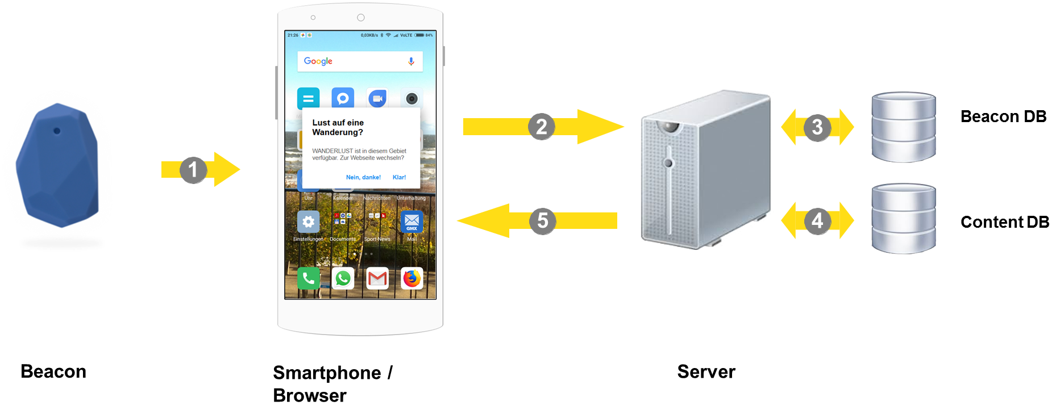
Closer look @ WANDERLUST Architecture
Exemplary procedure
A Beacon sends its unique Eddystone UID and an Eddystone URL via Bluetooth Low Energy. A compatible smartphone receives the UID and the URL and gives the user a push message on the display that a function of a beacon is available.
If the user wants to use the function of the beacon, the smartphone addresses a server by a RESTful API and pass UID to the server.
The server passes the UID to the Beacon DB and gets back a content URL which can be used to connect to the content DB.
The server requests the content of the Content DB identified by the unique URL and returns the content in a readable format e.g. JSON to the server.
The server pushes the content of the Content DB to the smartphone and back to the user.

Slide 15
2. Exploration

Slide 16
PROTO.IO
Simple and fast SaaS for Mockups
Possibility to display interactive mockups on mobile devices
Real app feeling without any coding

Slide 17
UI – Screens (1)
Popup triggered by BLE-Beacon near to start point of hiking track
User has the possibility to switch to the WANDERLUST website or ignore the service

Slide 18
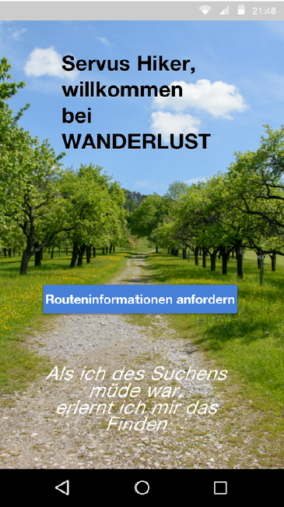
UI – Screens (2)
Landing page of WANDERLUST
User can request track information

Slide 19
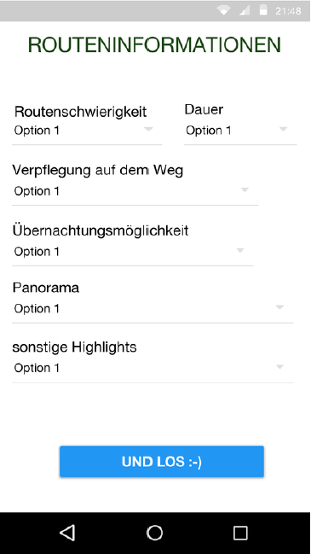
UI – Screens (3)
User can enter several filter options to find the perfect track

Slide 20
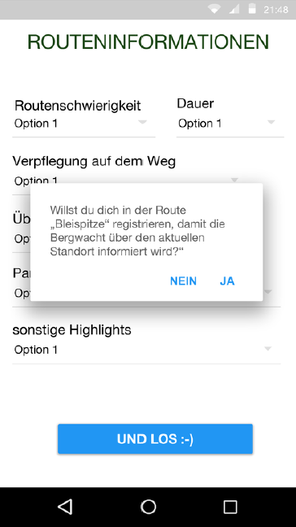
UI – Screens (4)
After the decision for a specific track WANDERLUST offers the possibility to register with the mountain rescue service

Slide 21
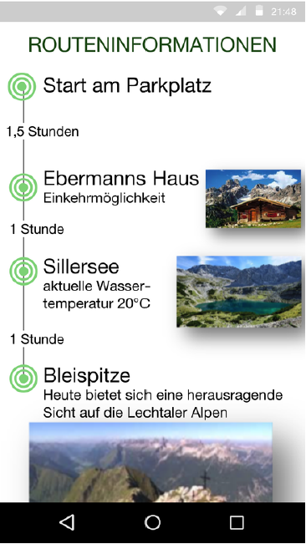
UI – Screens (5)
WANDERLUST provides the user an overview of the important waypoints on the selected track
Including pictures and short descriptions for the waypoints
Average times between the waypoints are displayed

Slide 22
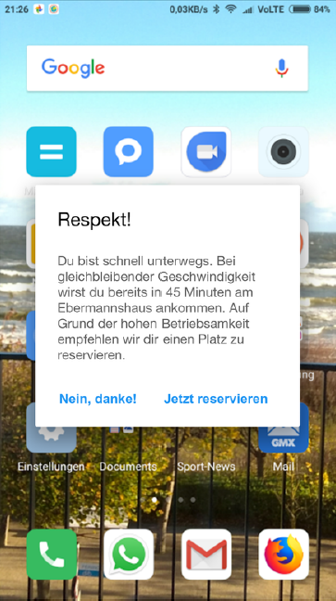
UI – Screens (6)
Informational popups
about estimated time to the next waypoint
the possibility to make a seat reservation at the next restaurant

Slide 23
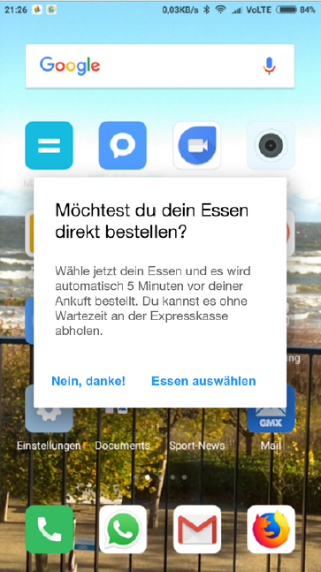
UI – Screens (7)
If the user uses the possibility to reserve a seat it is also possible to preselect a meal and pick up without waiting time at an express line

Slide 24
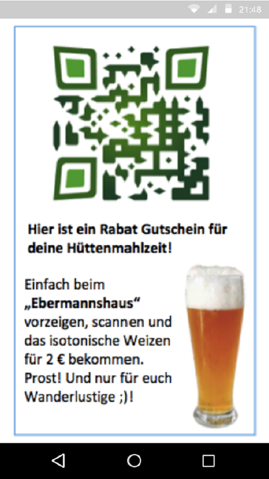
UI – Screens (8)
Special offers could be provided via QR-Code

Slide 25
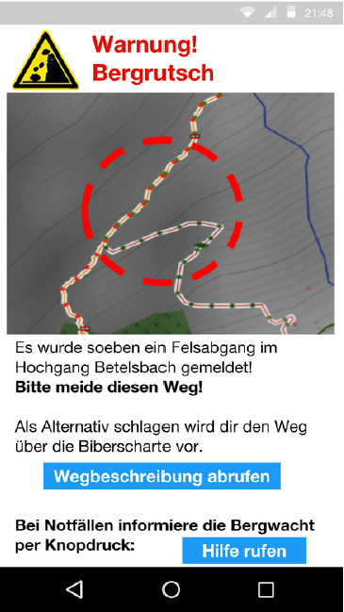
UI – Screens (9)
If necessary security information are pushed on the users device
Of course alternative tracks and the possibility for a one-click emergency call are provided

Slide 26
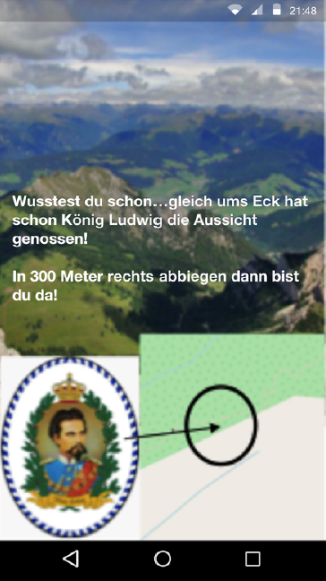
UI – Screens (10)
Information about interesting spots around the user are pushed through beacons
Also including historical and funny facts

Slide 27
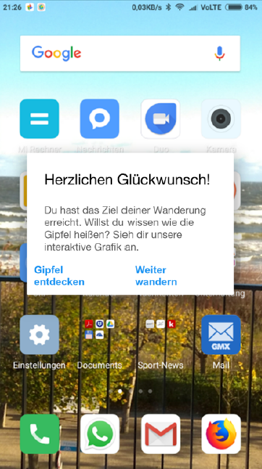
UI – Screens (11)
Congratulation screen after reaching the summit
Offers an interactive map of the surrounding mountains

Slide 28
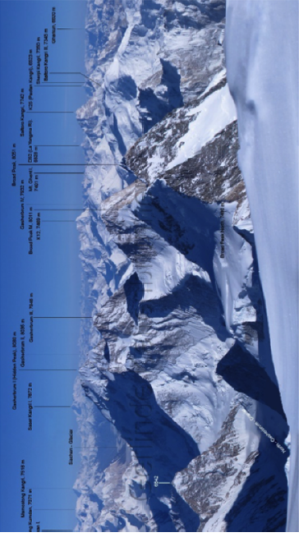
UI – Screens (12)
Interactive map of surrounding mountains
Maybe in a later stage including AR

Slide 29
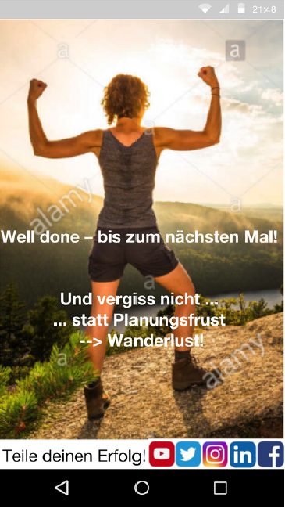
UI – Screens (13)
Success screen
Engage the user to share the reached achievements on social media
Remind the user to use WANDERLUST again

Slide 30
3. Experimentation

Slide 31
User Story Mapping
From the car park through the hike
User
Selection of the hiking trail
Hiking tour part one: Start
Hiking tour part two: Lunch break
Hiking tour part three: End
Receive the info push from the Beacon
Start hiking the route from the car park
Receive location based information (e.g. restaurant recommendation, special offers)
Share the experience via social media after the hike
Set your personal preferences. Length, view points and break point for lunch.
Guided tour through the trail
MVP
Receive location based information (e.g. best view, environment)
Have a break
Register in the trail for additional rescue service
Receive location based environmental information (e.g. landslide with alternative route)
Browse to the recommended hiking trail
Trail information with weather conditions
Take and post pictures through the hiking experience
Give a extended feedback
Release 1
Rate the viewpoints
Rate the hiking trail (standard 5 star rating system)
Personal preference: Fitness program
Info push: special offers from mountain huts
If needed adjust the trail to the personal conditions
Release 2
Rate the lunch place
Random trail generator
Info push: warnings if the weather conditions change

Slide 32
Defining the WANDERLUST - MVP
Basic artefacts and functions of the MVP
Selection of the hiking trail
First touchpoint, welcome to WANDERLUST: Receive the info push from the Beacon
Your route your choices, full customer centricity: Set your personal preferences. Length, view points and break point for lunch.
Safety first: Register in the trail for additional rescue service
Route recommendation: Browse to the recommended hiking trail
Hiking tour part one: Start
Proactive guided route: Guided tour through the trail
The route talks to you - embedded feeling: Receive location based information (e.g. best view, environment)
Hiking tour part two: Lunch break
Location based information: Receive information about e.g. restaurant and special offers
Event based information: Receive environmental information (e.g. landslide warning)
Hiking tour part three: End
Social component: Share the experience via social media after the hike

Slide 33

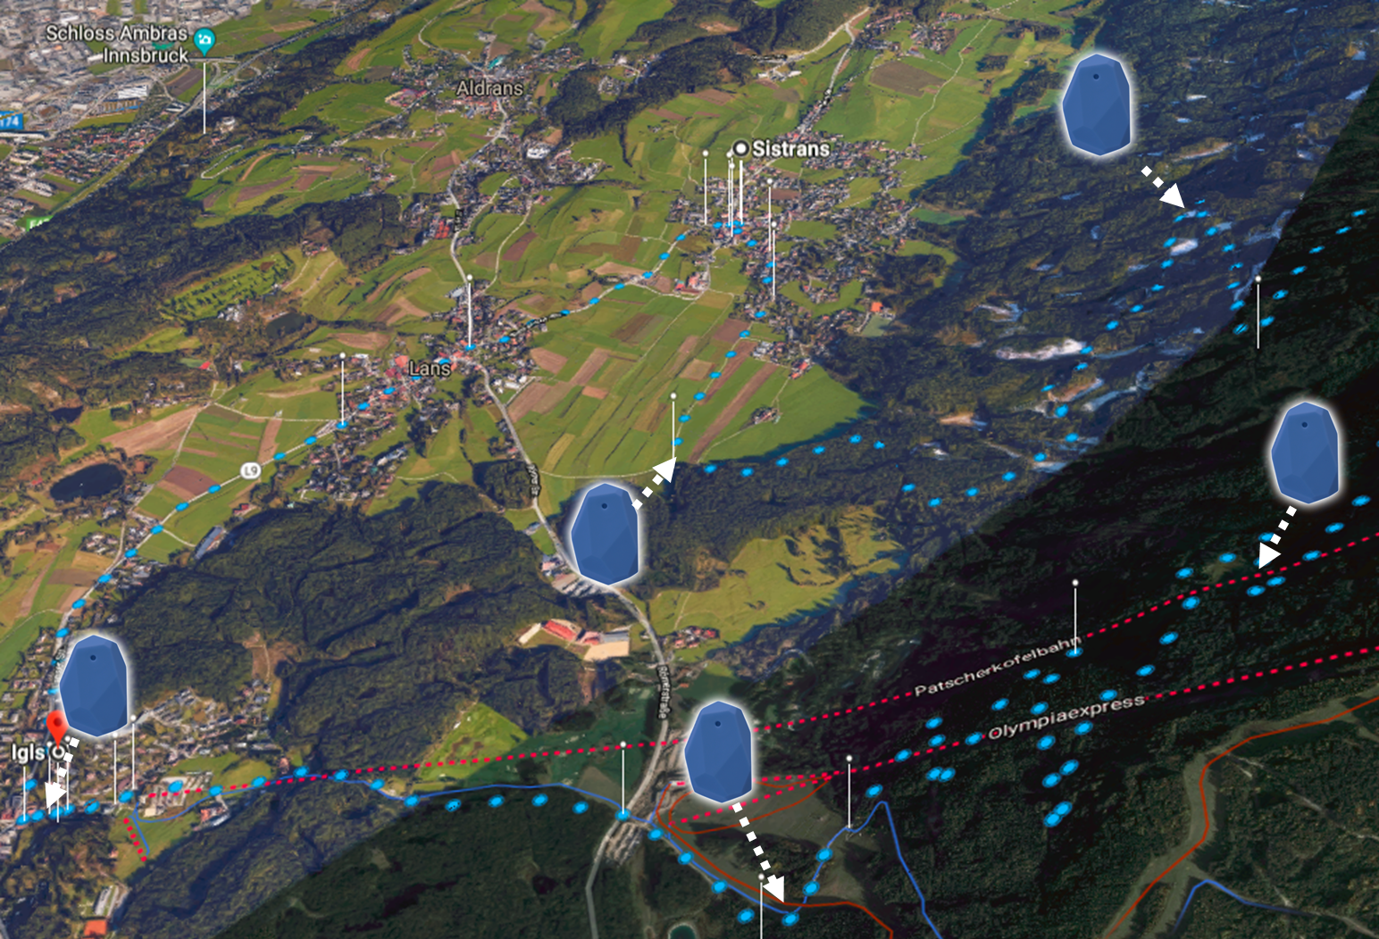

MVP - Route
Hiking as a Service
Share the experience via social media after the hike
info push
(URL)
Receive the info push from the Beacon
Set your personal preferences. Length, view points and break point for lunch.
Register in the trail for additional rescue service
Hiking tour part three: End
Smartphone
Cloud
Browse to the recommended hiking trail
Hiking tour part two: Lunch break
Selection of the hiking trail
Receive location based information (e.g. restaurant recommendation, special offers)
Start hiking the route from the car park
Have a break
Hiking tour part one: Start
Guided tour through the trail
Receive location based environmental information (e.g. landslide with alternative route)
Receive location based information (e.g. best view, environment)
Beacon
Each beacon is represented by an URL

Slide 34
Living Lab Setup
Setup
Estimote Proximity Beacons (BLE 4.0)
Selected hiking track
Prototype app (on a smartphone able to communicate with beacons) and web service
User
Hiker (age 20-40)
Service provider employee (for infrastructure support)
Required data for evaluation
Feedback on application
Feedback on beacon location
Feedback on seamless interaction
Feedback on provided routing/ information
Lock & feel UI
Maintenance & update process for beacons/infrastructure

Slide 35
4. Evaluation

Slide 36
Possible results from Experimentation phase
User feedback from various perspectives:
Application design
Performance
Functional range
Availability
Traceability
Update frequency
Beacons update process
Service provider employee feedback: Update process for beacons is to complex, because it is necessary to cover the complete track manually
Hiker feedback: Create introduction/explanation on starting point to explain the WANDERLUST service

Slide 37
Living Lab
Second iteration
1.
4.
2.
3.

Slide 38
1. Co.-Creation

Slide 39
Rethink MVP & technology usage
Change Beacon technology from single BLE 4.0 communication to LTE/BLE 4.0 communication
BeWhere M-IOT Beacons enable wide distance information update on beacons via LTE
Communication to user smartphone is still based on BLE 4.0
Reduced maintenance/update effort for beacons
Add WANDERLUST symbol and explanation on starting point of the covered hiking tracks
→ Reduce confusion after first popup from Beacon that the WANDERLUST service is available

